Slide 1
Recurrence relation
DSA II
UMAMA RAHMAN

Slide 2
Recurrence equation of time complexity of Recursive functions

Slide 3
Example-1
int fib(int n) { if (n <= 1) return n; return fib(n - 1) + fib(n - 2); }
 | O(1)/c (constant)
 | T(n-1) + T(n-2)
$$T\left(n\right)=T\left(n−1\right)+T\left(n−2\right)+c$$

Slide 4

Example-2
int factorial(int n) { if (n <= 1) return 1; return n * factorial(n - 1); }
 | O(1) / c (constant)
 | T(n-1)
$$T\left(n\right)=T\left(n−1\right)+c$$

Slide 5
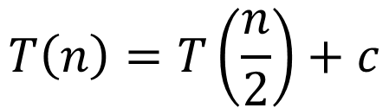
Example-3
int binarySearch(int ar[], int l, int r, int x) { if (l>r) return -1; int mid = l + (r - l) / 2; if (a[mid] == x) return mid; if (a[mid] > x) return binarySearch(a, l, mid - 1, x); else return binarySearch(a, mid + 1, r, x); } | Line 2-4: O(1)/c From line 5 to 8: The array is divided into equal 2 halves and based on the condition we call recursive function for any half array. So, time complexity, T(n)=T(n/2)
$$T\left(n\right)=T\left(\frac{n}{2}\right)+c$$

Slide 6
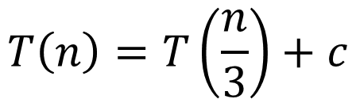
Example-4
int ternarySearch(int a[], int l, int r, int x) { if (l <= r) { int m1 = l + (r - l) / 3; int m2 = r - (r - l) / 3; if (a[m1] == x) return m1; if (a[m2] == x) return m2; if (x < a[m1]) return ternarySearch(a, l, m1 - 1, x); else if (x > a[m2]) return ternarySearch(a, m2 + 1, r, x); else return ternarySearch(a, m1 + 1, m2 - 1, x); } return -1; } | Line 2-6: O(1)/c From line 7 to 9: The array is divided into equal 3 parts and based on the condition we call recursive function for any of the 3 arrays. So, time complexity, T(n)=T(n/3) Line 11: O(1)
$$T\left(n\right)=T\left(\frac{n}{3}\right)+c$$

Slide 7
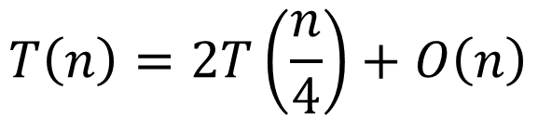
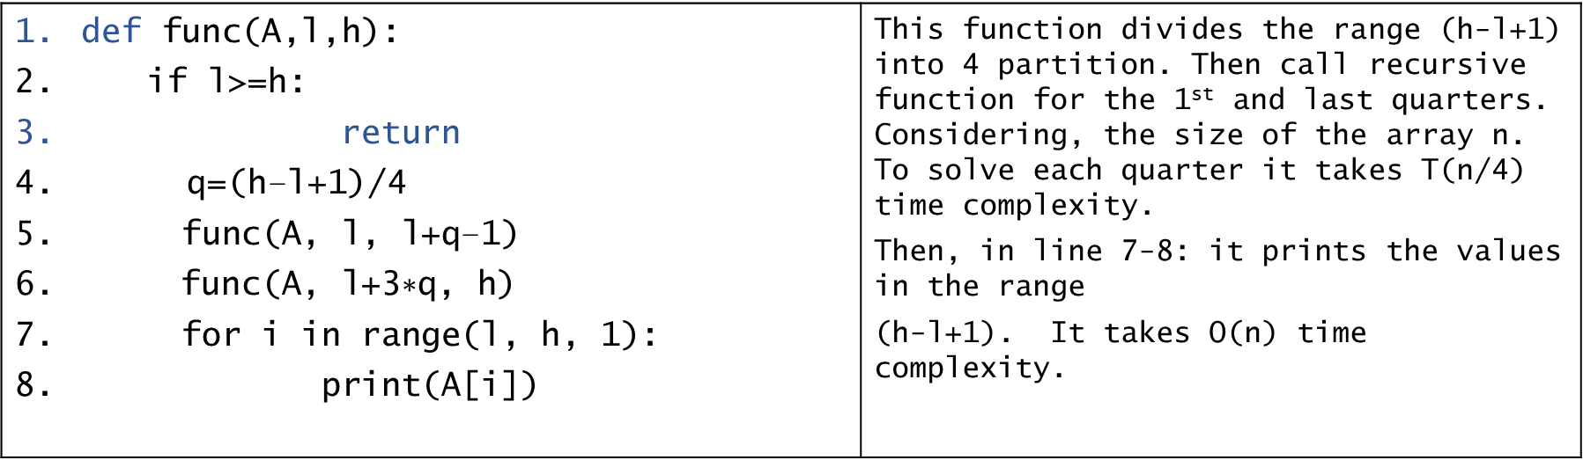
Example-5
$\text{def} \text{func}\text{(}\text{A}\text{,}\text{l}\text{,}\text{h}\text{): }$ $\text{if} \text{l}\text{>=}\text{h}\text{: }$ $\text{return}$ $\text{q}\text{=(}\text{h}\text{−}\text{l}\text{+1)/4 }$ $\text{func}\text{(}\text{A}\text{, }\text{l}\text{, }\text{l}\text{+}\text{q}\text{−1) }$ $\text{func}\text{(}\text{A}\text{, }\text{l}\text{+3∗}\text{q}\text{, }\text{h}\text{) }$ $\text{for} \text{i} \text{in} \text{range}\text{(}\text{l}\text{, }\text{h}\text{, }\text{1): }$ $\text{print}\text{(}\text{A}\text{[}\text{i}\text{]) }$ | This function divides the range (h-l+1) into 4 partition. Then call recursive function for the 1st and last quarters. Considering, the size of the array n. To solve each quarter it takes T(n/4) time complexity. Then, in line 7-8: it prints the values in the range (h-l+1). It takes O(n) time complexity.
$$T\left(n\right)=2T\left(\frac{n}{4}\right)+O\left(n\right)$$

Slide 8
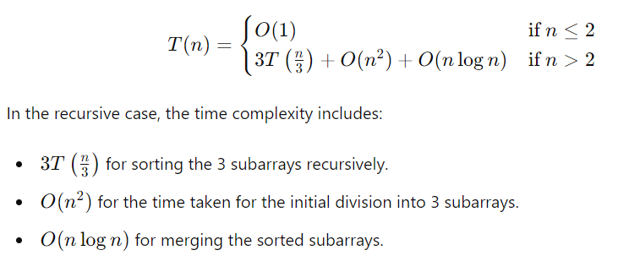
Find recurrence relation
Consider a modified version of the Merge sort algorithm as follows:
If the array size is less than or equal to 2, then it sorts the array at constant time.
Otherwise, it divides the array of size n into 3 subarrays, each with a size of n/3. This division takes O(n^2) time. Then the algorithm sorts the subarrays recursively, and then merges their solutions in time O(nlogn). Write a recurrence relation for the running-time T(n) of this algorithm.

Slide 9
Solving recurrence equation

Slide 10
Solving recurrence relation
Recurrence relations can be solved using
Master theorem
Recursion tree
Substitute method
We will discuss the 1st 2 methods in this course.

Slide 11
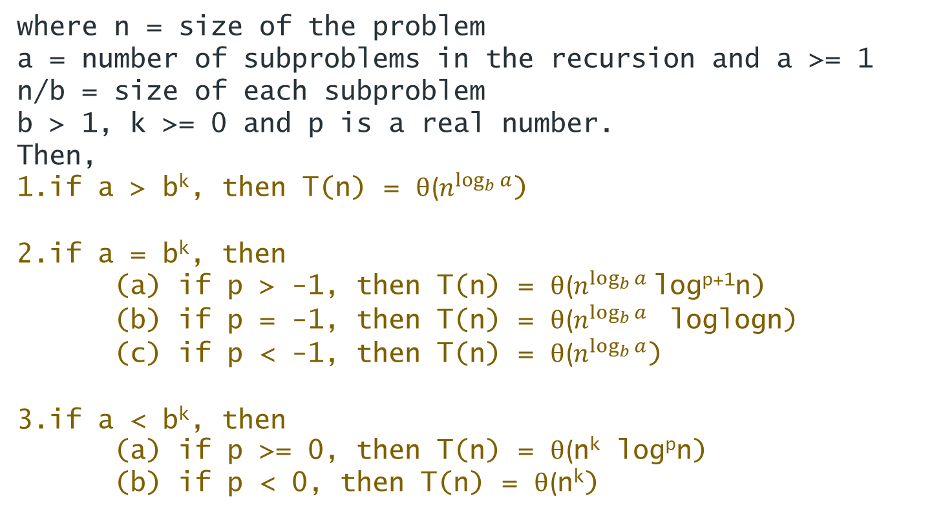
Master theorem
Consider the recurrence relation
where n = size of the problem a = number of subproblems in the recursion and a >= 1 n/b = size of each subproblem b > 1, k >= 0 and p is a real number.
Then,
if a > b^{k}, then T(n) = θ($n^{\log_{b}{a}}$)
if a = b^{k}, then (a) if p > -1, then T(n) = θ($n^{\log_{b}{a}}$log^{p+1}n) (b) if p = -1, then T(n) = θ($n^{\log_{b}{a}}$ loglogn) (c) if p < -1, then T(n) = θ($n^{\log_{b}{a}}$)
if a < b^{k}, then (a) if p >= 0, then T(n) = θ(n^{k} log^{p}n) (b) if p < 0, then T(n) = θ(n^{k})

Slide 12
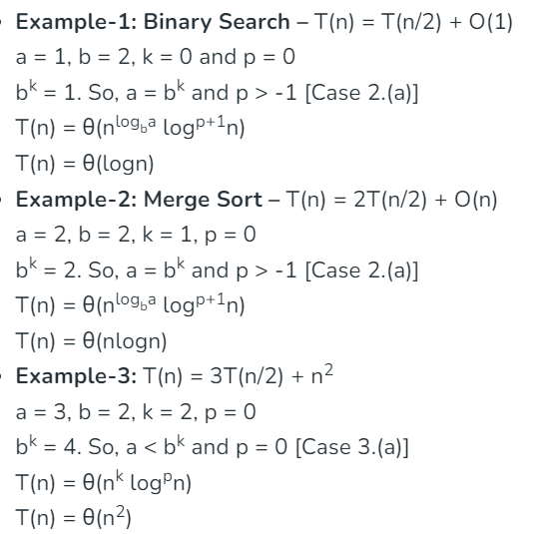
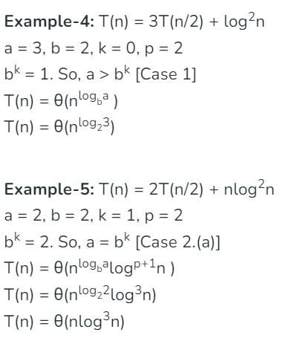
Examples

Slide 13
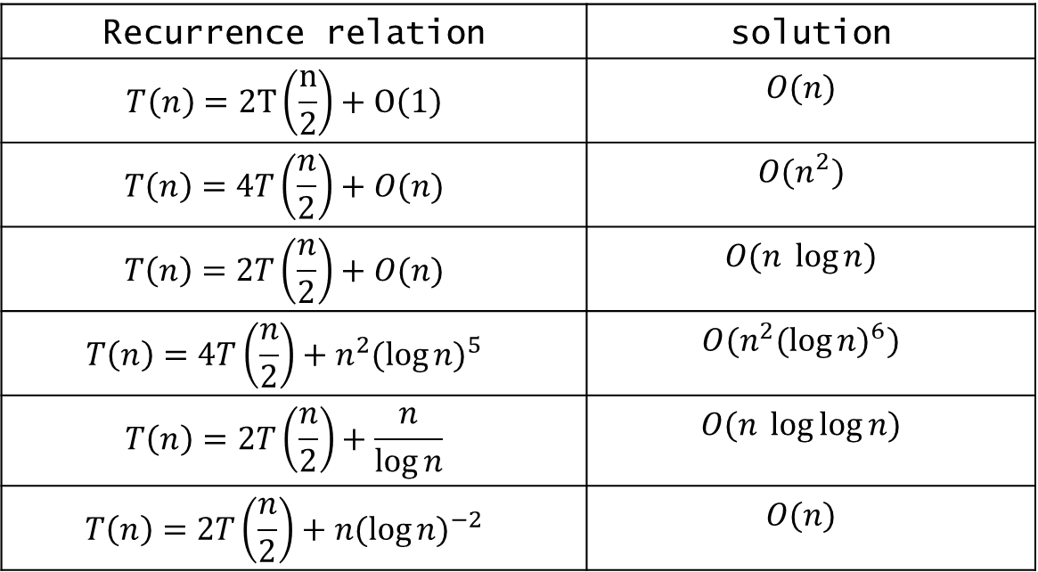
More practices
Recurrence relation | solution
$$T\left(n\right)=2T\left(\frac{n}{2}\right)+O\left(1\right)$$ | $$O(n)$$
$$T\left(n\right)=4T\left(\frac{n}{2}\right)+O(n)$$ | $$O(n^{2})$$
$$T\left(n\right)=2T\left(\frac{n}{2}\right)+O(n)$$ | $$O(n \log{n)}$$
$$T\left(n\right)=4T\left(\frac{n}{2}\right)+n^{2}{(\log{n)}}^{5}$$ | $$O(n^{2}{(\log{n)}}^{6})$$
$$T\left(n\right)=2T\left(\frac{n}{2}\right)+\frac{n}{\log{n}}$$ | $$O(n \log{\log{n)}}$$
$$T\left(n\right)=2T\left(\frac{n}{2}\right)+n{(\log{n)}}^{−2}$$ | $$O(n)$$

Slide 14
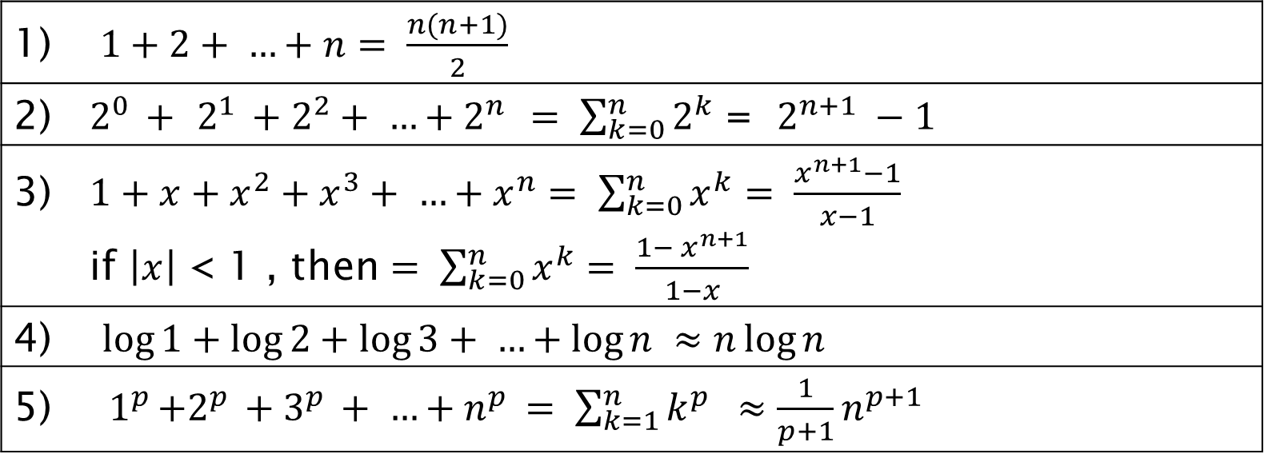
Some Important Formulas
1) $1+2+ …+n= \frac{n(n+1)}{2}$
2) $2^{0 }+$ $2^{1 }+2^{2}+ …+2^{n }= \sum_{k=0}^{n}{2^{k}}$ = $2^{n+1} −1$
3) $1+x+x^{2}+x^{3}+ …+x^{n}= \sum_{k=0}^{n}{x^{k}= \frac{x^{n+1}−1}{x−1}}$ if $\left|x\right|$ < 1 , then $= \sum_{k=0}^{n}{x^{k}= \frac{{1− x}^{n+1}}{1−x}}$
4) $\log{1}+\log{2}+\log{3+ …+\log{n} ≈n\log{n}}$
5) ${ 1}^{p }+2^{p }+3^{p }+ …+n^{p }= \sum_{k=1}^{n}{k^{p } ≈\frac{1}{p+1}n^{p+1 }}$
***Important note: if $\left|x\right|$ < 1 , then $x^{something }<1$

Slide 15
Solving recurrence using recursive tree
Steps to solve recurrence relation using recursion tree method:
Draw a recursive tree for given recurrence relation
Calculate the cost at each level and count the total no of levels in the recursion tree.
Count the total number of nodes in the last level and calculate the cost of the last level
Sum up the cost of all the levels in the recursive tree

Slide 16
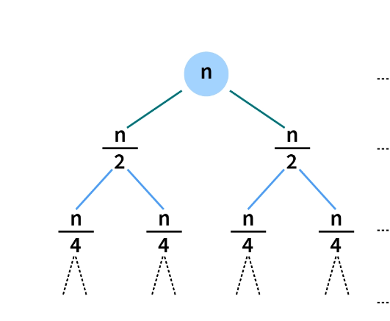
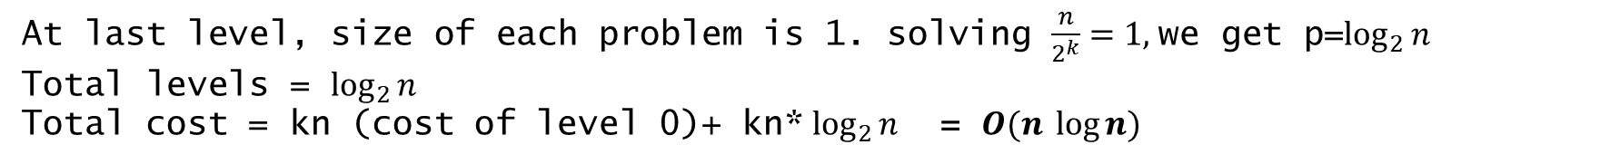
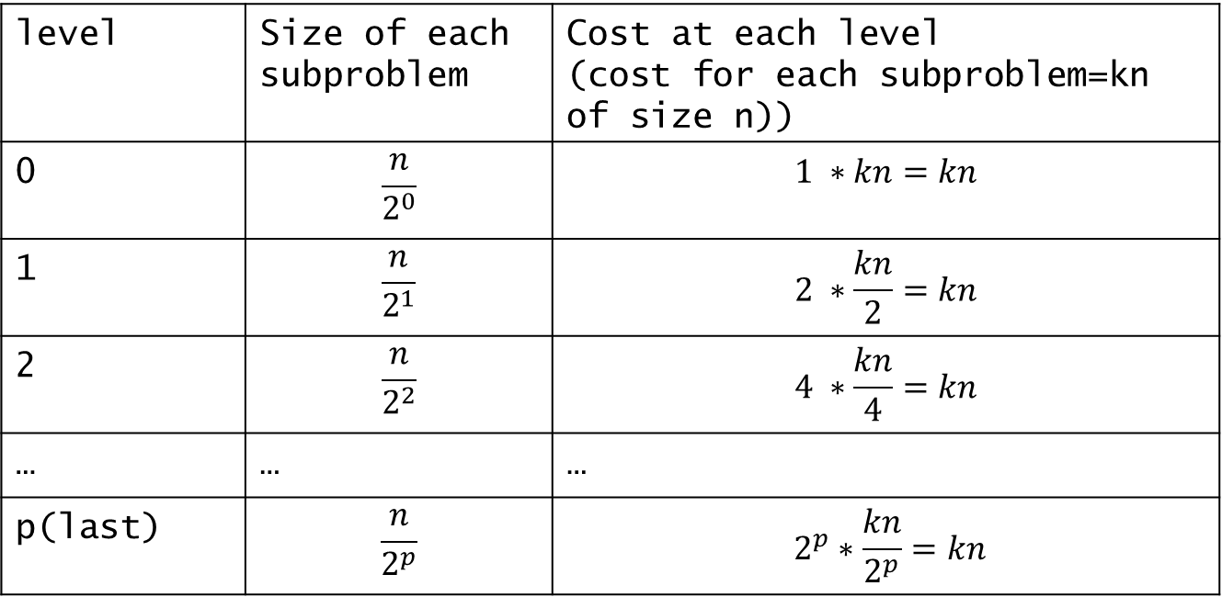
$$T\left(n\right)=2T\left(\frac{n}{2}\right)+kn$$
level | Size of each subproblem | Cost at each level (cost for each subproblem=kn of size n))
0 | $$\frac{n}{2^{0}}$$ | $$1 ∗kn=kn$$
1 | $$\frac{n}{2^{1}}$$ | $$2 ∗\frac{kn}{2}=kn$$
2 | $$\frac{n}{2^{2}}$$ | $$4 ∗\frac{kn}{4}=kn$$
… | … | …
p(last) | $$\frac{n}{2^{p}}$$ | $$2^{p}∗\frac{kn}{2^{p}}=kn$$
Draw recursive tree
At last level, size of each problem is 1. solving $\frac{n}{2^{k}}=1,$we get p=$\log_{2}{n}$
Total levels = $\log_{2}{n}$
Total cost = kn (cost of level 0)+ kn* $\log_{2}{n}$ = $O(n \log{n)}$

